Slide 1


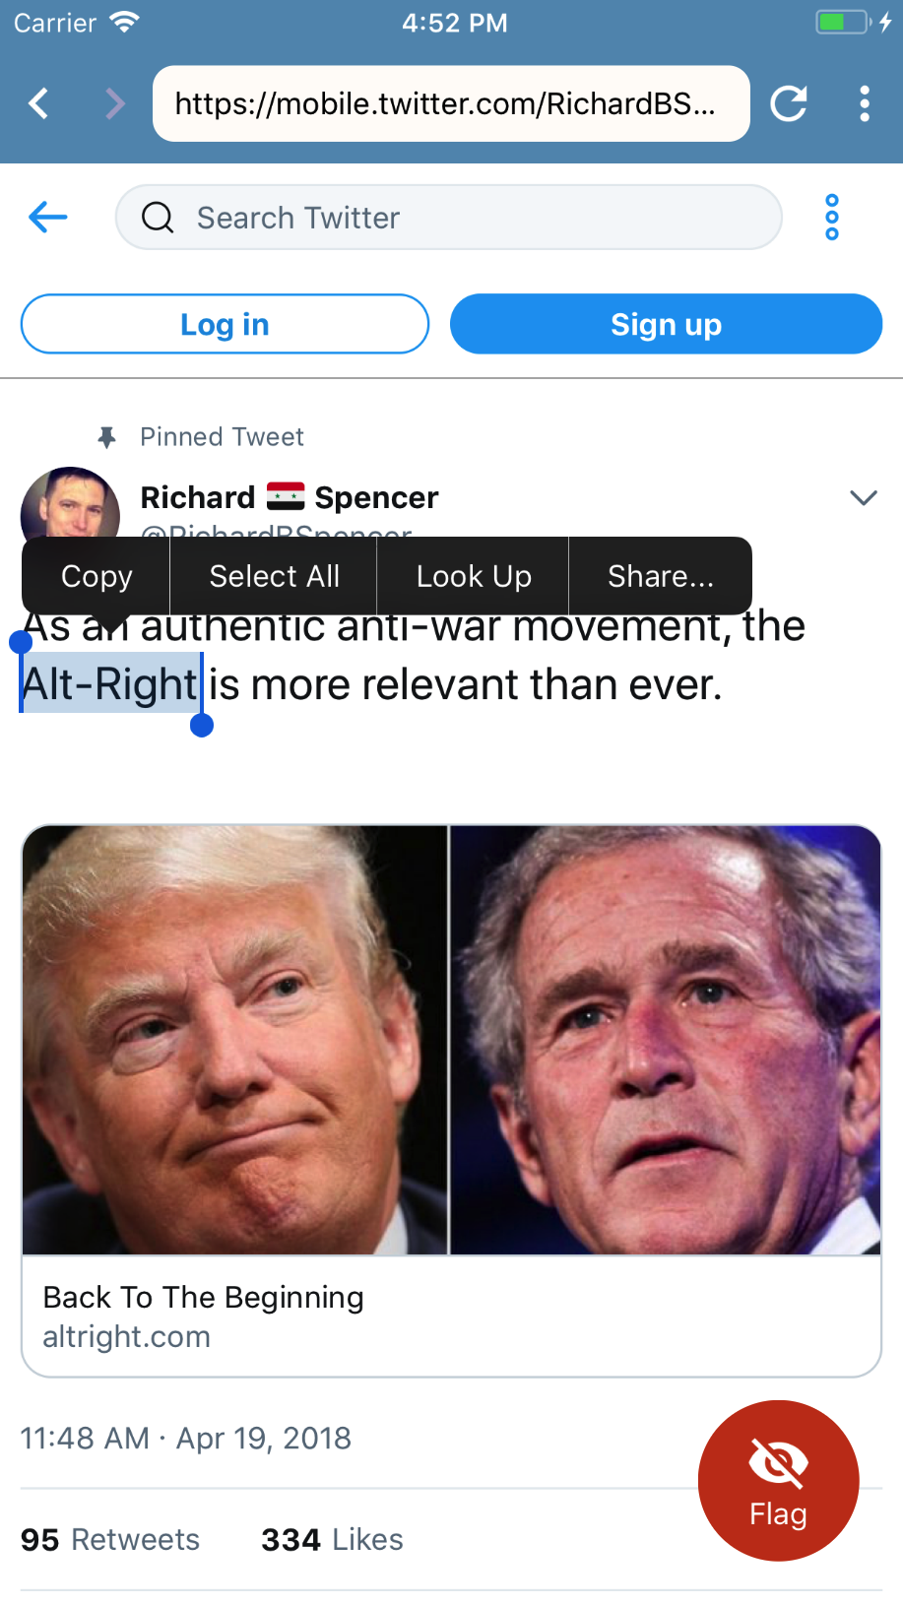
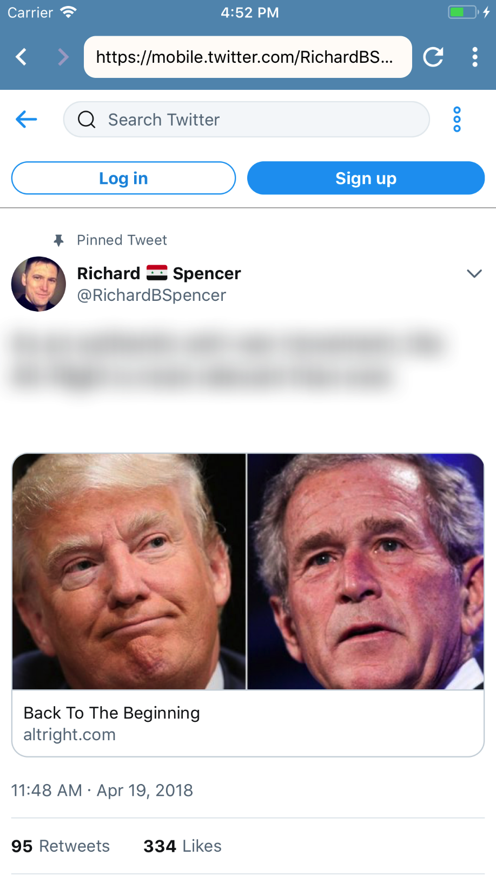


















Personalized Micro-Content Filtering for Hate Speech
Problems:
Bullying and hate speech rampant on content platforms
The definition of hate speech is subjective, so any shared definition used for whole user populations is by necessity very conservative
Ad-supported platforms are not incentivized to remove harmful content
Platforms have a history of abusing power to remove content and maliciously censoring vulnerable groups
Removing hateful content contributes to persecution complexes and radicalization of hate groups
Content removal based on community triage occurs too late to prevent harm
Solutions:
Shift power from content platforms to users
Prevent ideological conflict escalation by eliminating escalation triggers
Personalize approach for each individual user
Machine learning NLP based on word embeddings helps users efficiently build personalized algorithmic definitions of hate speech
Project serves generally as a novel rhetorical device in conversations about free speech and censorship
“You may have the right to say whatever you want, but you don’t have the right to force me to listen to you.” -Casey
Major Features:
Fully functional mobile web browser
Supported on Android and iOS
Filters undesired content automatically on page load
Allows user to see filtered content if they desire
Unique filtering model for each user
Filter improves with use

